Slide 1
Breast Cancer
Creating Analytical Models to Predict
Roxana Rivkani
Springboard- Data Science

Slide 2
Identify The Problem
Breast cancer is the most common malignancy among women, accounting for nearly 1 in 3 cancers diagnosed among women in the United States, and it is the second leading cause of cancer death among women. Breast Cancer occurs as a results of abnormal growth of cells in the breast tissue, commonly referred to as a Tumor. A tumor does not mean cancer - tumors can be benign (not cancerous), pre-malignant (pre-cancerous), or malignant (cancerous). Tests such as MRI, mammogram, ultrasound and biopsy are commonly used to diagnose breast cancer performed.

Slide 3
Objective & Expected Outcome
Given breast cancer results from breast fine needle aspiration (FNA) test (is a quick and simple procedure to perform. Our goal is to build a model that can classify a breast cancer tumor using two training classification:
1= Malignant (Cancerous)
0= Benign (Not Cancerous)

Slide 4
Data & Resources
The data is taken from the Breast Cancer Wisconsin Center(https://archive.ics.uci.edu/ml/datasets/Breast+Cancer+Wisconsin+(Diagnostic). The dataset contains 569 samples of malignant and benign tumor cells. Since the labels in the data are discrete, the predication falls into two categories, ( Malignant or benign). In machine learning this is a classification problem.
The first two columns in the dataset store the unique ID numbers of the samples and the corresponding diagnosis (M=malignant, B=benign), respectively.
The columns 3-32 contain 30 real-value features that have been computed from digitized images of the cell nuclei, which can be used to build a model to predict whether a tumor is benign or malignant.

Slide 5
Data & Resources
The data is taken from the Breast Cancer Wisconsin Center(https://archive.ics.uci.edu/ml/datasets/Breast+Cancer+Wisconsin+(Diagnostic). The dataset contains 569 samples of malignant and benign tumor cells. Since the labels in the data are discrete, the predication falls into two categories, ( Malignant or benign). In machine learning this is a classification problem.
The first two columns in the dataset store the unique ID numbers of the samples and the corresponding diagnosis (M=malignant, B=benign), respectively.
The columns 3-32 contain 30 real-value features that have been computed from digitized images of the cell nuclei, which can be used to build a model to predict whether a tumor is benign or malignant.

Slide 6
Exploratory Data Analysis
Exploratory data analysis (EDA) is a very important step which takes place after feature engineering and acquiring data and it should be done before any modeling. This is because it is very important for a data scientist to be able to understand the nature of the data without making assumptions. The results of data exploration can be extremely useful in grasping the structure of the data, the distribution of the values, and the presence of extreme values and interrelationships within the data set.
Descriptive statistics
Visualization

Slide 7
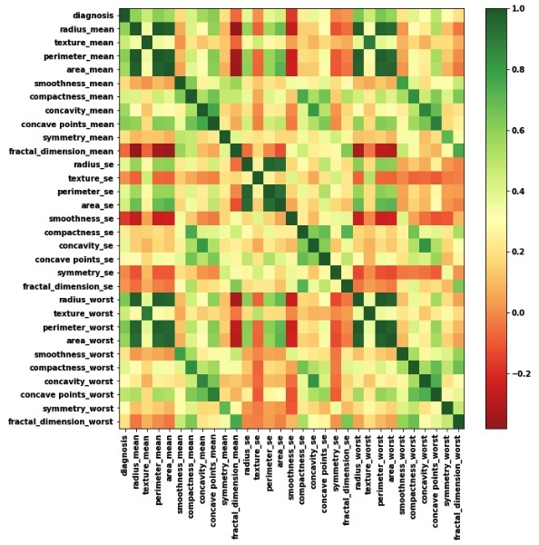
Heatmap & Feature Selection
The mean area of the tissue nucleus has a strong positive correlation with mean values of radius and parameter;
Some parameters are moderately positive correlated, like concavity and area, concavity and perimeter etc
Likewise, we see some strong negative correlation between fractal_dimension with radius, texture, parameter mean values.

Slide 8
Classification & Cross Validation
Assigning numerical values to categorical data;
Handling missing values; and
Normalizing the features (so that features on small scales do not dominate when fitting a model to the data).
In statistical modeling and machine learning, a commonly-reported performance measure of model accuracy for binary classification problems. For this purpose, i’ve choose, KNN neighbor classifier, Decision tree, Random forest, Gaussian NB, SVM and Ada boost. After the initial training, the most accurate model is Ada boost and second is Random forest. AdaBoost, short for “Adaptive Boosting”, is the first practical boosting algorithm proposed by Freund and Schapire in 1996. It focuses on classification problems and aims to convert a set of weak classifiers into a strong one. As we can see, is takes more time to train the model but the has better accuracy compare to the others.

Slide 9
Conclusion
Precision helps when the costs of false positives are high, and Recall helps when the cost of false negatives is high. In this project, we are working on cancer detection problem and a false negative has devastating consequences. Statistics provides us with the formal definitions and the equations to calculate these measures. Data science is about knowing the right tools to use for a job, and often we need to go beyond accuracy when developing classification models. Also, I took another step to get a result of precision and recall from test and train dataset separately to make sure the model is not causing overfitting or under-fitting. The result shows the best models are Ada boost and random forest which are the known for classification problems.

